Slide 1
College Admission Agent ( RAG Based )
IBM AICTE PROJECT
Presented By:
Nandhayogesh K S
Mahendra College of Engineering
Computer Science and Engineering

Slide 2
OUTLINE
Problem Statement (Should not include solution)
Proposed System/Solution
System Development Approach (Technology Used)
Algorithm & Deployment
Result (Output Image)
Conclusion
Future Scope
References

Slide 3
Problem Statement
The college admissions process is intricate, involving multiple criteria, policies, and documentation requirements which can be confusing for applicants. Due to the dispersed and frequently updated nature of information, students often struggle to make informed choices. Admission officers, meanwhile, face a high volume of repetitive queries, resulting in inefficiencies and potential delays. There is a need for an intelligent, scalable system to automate and enhance the admissions support process, grounded in institutional knowledge and capable of handling complex student inquiries.

Slide 4
Proposed Solution
We propose an AI-powered College Admission Agent that utilizes Retrieval-Augmented Generation (RAG), built on IBM Cloud Lite Services and the IBM Granite LLM family. The system leverages IBM’s cloud-native solutions for secure infrastructure, seamless integration, and scalable deployment, while IBM Granite provides advanced, enterprise-grade language modeling for generating contextually accurate, grounded responses to admissions queries. The RAG pipeline securely retrieves up-to-date policy details, eligibility criteria, and requirements from institution-curated documents, enabling personalized and trustworthy guidance for both students and administrators.

Slide 5
System Approach
Language Model: IBM Granite (LLM service available on IBM Cloud)
Retrieval Engine: IBM Watson Discovery (for document indexing and semantic/keyword search)
Backend Platform: Python (Flask or FastAPI) deployed on IBM Cloud Code Engine or IBM Cloud Functions
Database: IBM Cloud Databases for PostgreSQL (structured data), IBM Cloud Object Storage (for documents and unstructured data)
Frontend: React.js web interface served via IBM Cloud App Service
Deployment and Management: IBM Cloud Kubernetes Service or IBM Cloud Foundry; Docker containers on IBM Cloud
Other Tools: IBM OpenAPI for API management; IBM Cloud Monitoring for system health and analytics
CI/CD and Security: IBM Cloud Continuous Delivery tools, IAM for authentication

Slide 6
Algorithm & Deployment
User submits a query via chat/web interface hosted on IBM Cloud App Service.
Backend API (Python Flask on IBM Cloud Code Engine) receives the query and coordinates processing.
Retrieval agent queries IBM Watson Discovery for relevant institutional documents and extracts key passages.
Retrieved content and the original question are passed to the IBM Granite LLM for response generation (using RAG).
IBM Granite generates a fact-based, contextual answer.
The system formats and delivers the answer to the user, optionally providing references and links to policy docs.

Slide 7
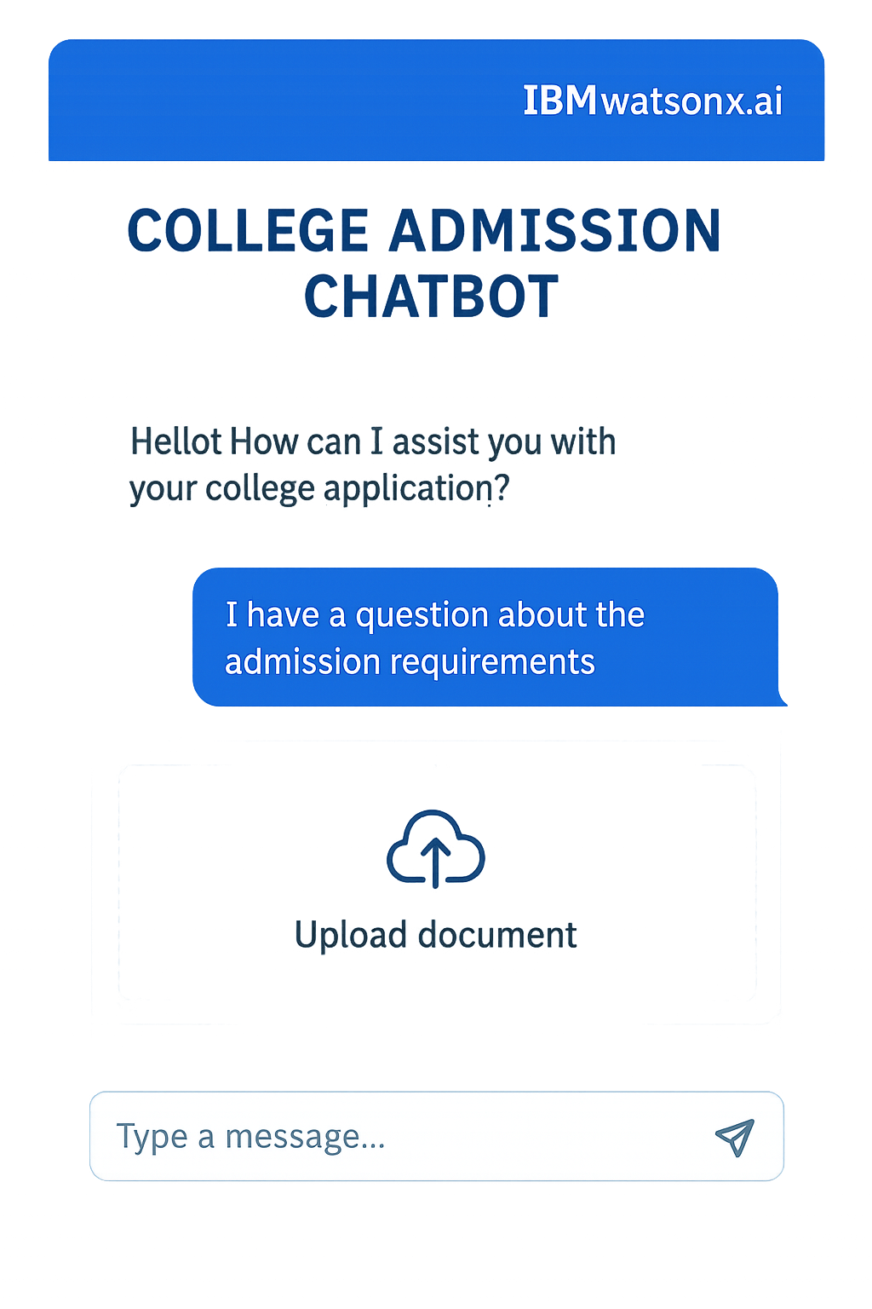
Result
A user interacts with the chat interface (built with React.js and hosted on IBM Cloud), asking: “Am I eligible for B.Tech in Mechanical Engineering with 78% in Class XII under OBC category?”
The system (powered via IBM Granite and Watson Discovery) responds: “Yes, you are eligible for B.Tech Mechanical Engineering under the OBC quota with 78%. Please ensure you upload your OBC certificate and marksheet. [See: College Prospectus 2025, pg.17].”
(Insert your actual chat UI screenshot here, clearly showing the IBM Cloud logo or watermark to indicate deployment on the IBM platform.)

Slide 8
Conclusion
The College Admission Agent, built using IBM Cloud Lite Services and IBM Granite LLM, delivers fast, trustworthy, and highly personalized admissions support. Leveraging IBM Watson Discovery for robust document retrieval and Granite for accurate language understanding, the system streamlines the admissions inquiry process, reduces workload for staff, and minimizes misinformation. Its modular, cloud-native architecture ensures adaptability and cost-effectiveness—perfect for institutions seeking a modern, enterprise-grade solution.

Slide 9
Future scope
Integrate with IBM Watson Assistant for natural language voice support.
Expand to multilingual support using IBM Granite’s multilingual models.
Offer a mobile version deployed using IBM Cloud Mobile Foundation.
Incorporate analytics dashboards for administrators using IBM Cognos Analytics.
Extend support for scholarship and placement queries by indexing additional document collections.

Slide 10
References
IBM, "IBM Granite: Next-generation Large Language Models," IBM Documentation, 2024.
IBM, "Watson Discovery: AI-Powered Search and Discovery," IBM Cloud Docs, 2025.
IBM, "Deploying Python Apps with IBM Cloud Code Engine," IBM Developer Tutorials, 2025.
Lewis, P., et al. "Retrieval-Augmented Generation for Knowledge-Intensive NLP Tasks," Advances in Neural Information Processing Systems, 2020.
University of Transport Technology, Vietnam – Case Study: RAG-based admissions agent on IBM Cloud, 2024.

Slide 11
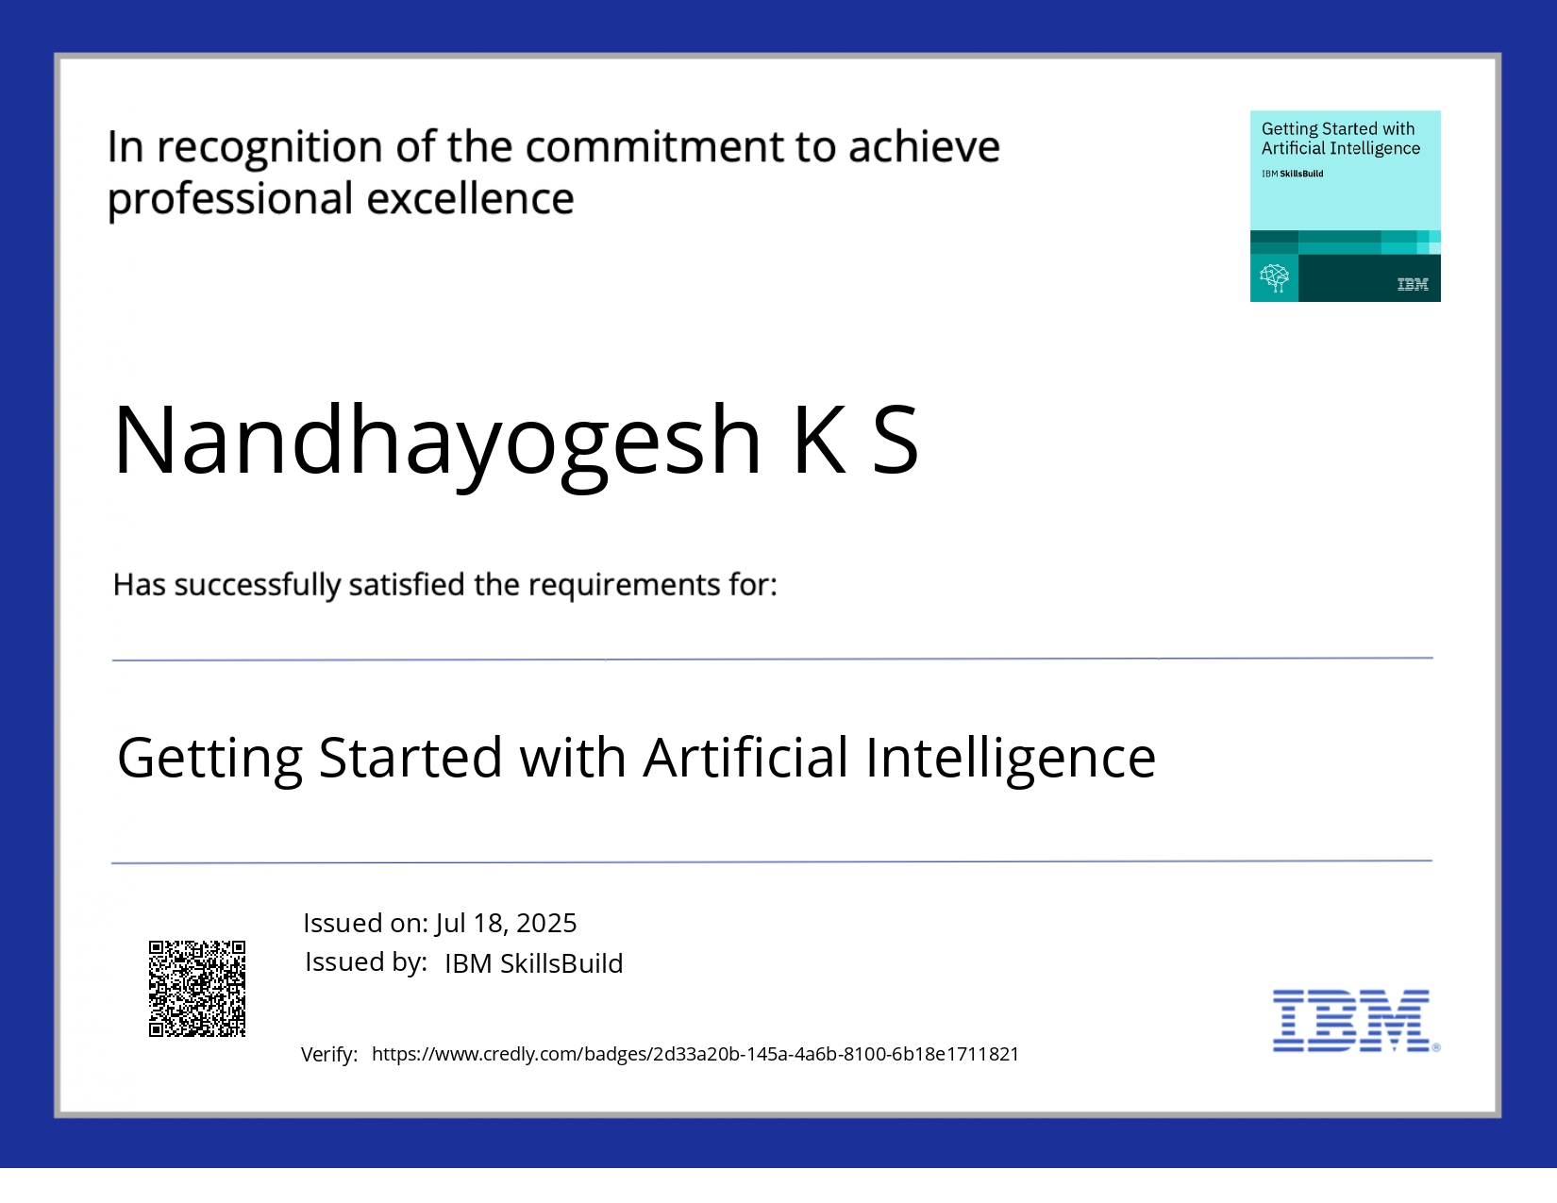
IBM Certifications
Screenshot/ credly certificate( getting started with AI)

Slide 12
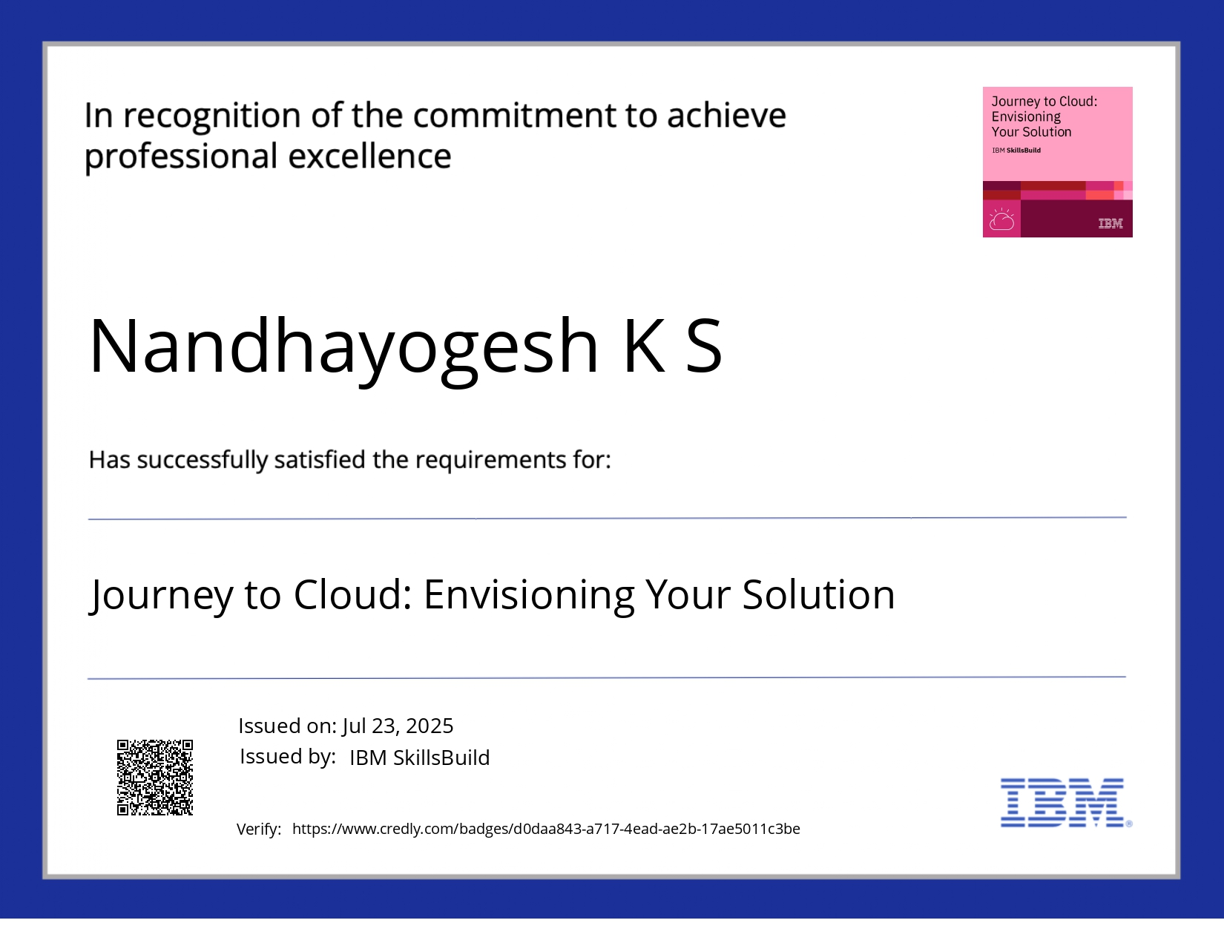
IBM Certifications
Screenshot/ credly certificate( Journey to Cloud)

Slide 13
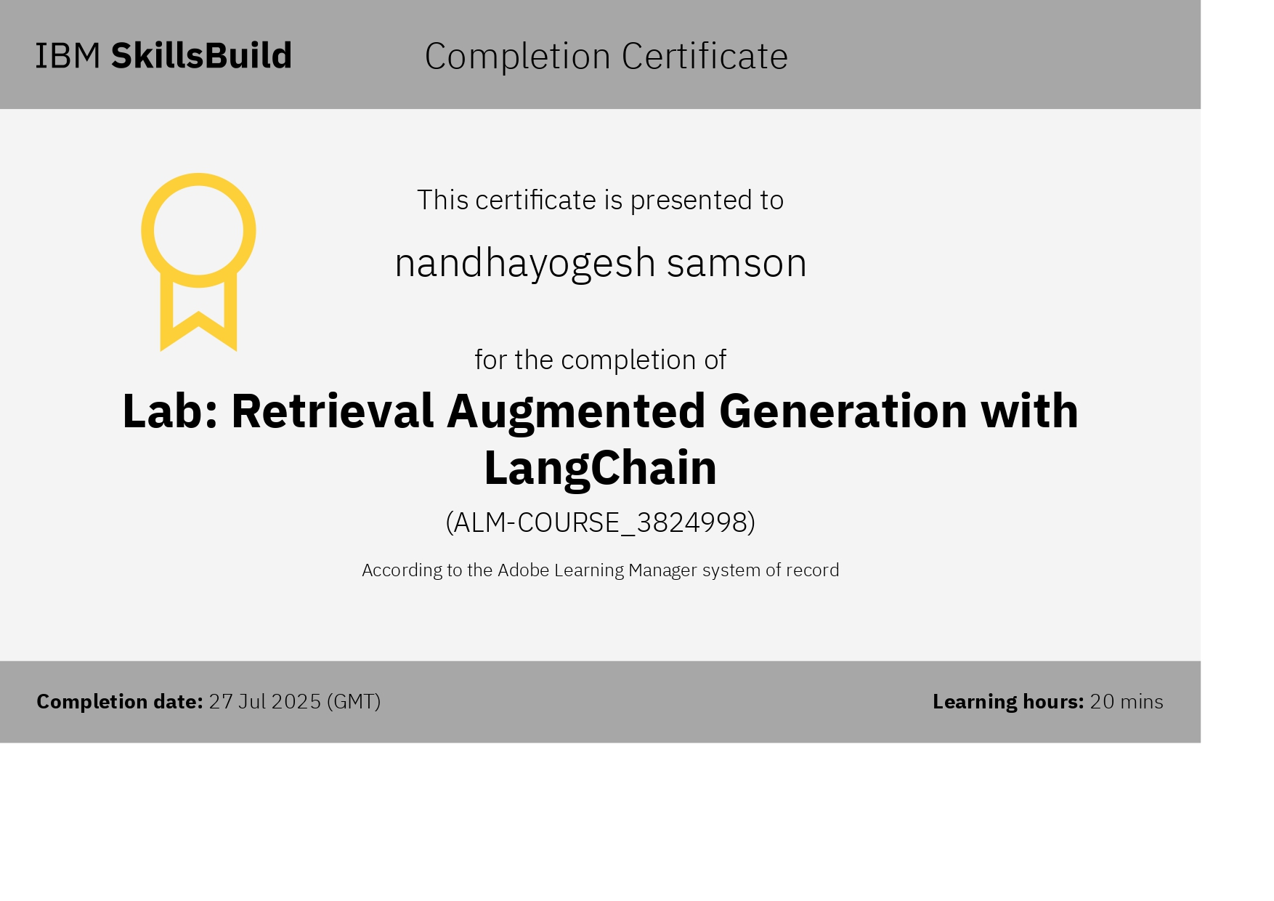
IBM Certifications
Screenshot/ credly certificate( RAG Lab)

Slide 14
THANK YOU

